Slide 1
BUILDING A CYBORG ARMY
USING DIGITAL TOOLS TO SUPERCHARGE YOUR REAL-LIFE VOLUNTEERS
Web: www.dylancate.com
Email: dycate@gmail.com
Notes:
- Typical funnel is online -> offline. Digital as comms – broadcast in new channels, get some sort of shallow engagement, but still broadcast. Here we’ll think of digital as toolset to make the work your field volunteers are doing more effective

Slide 2
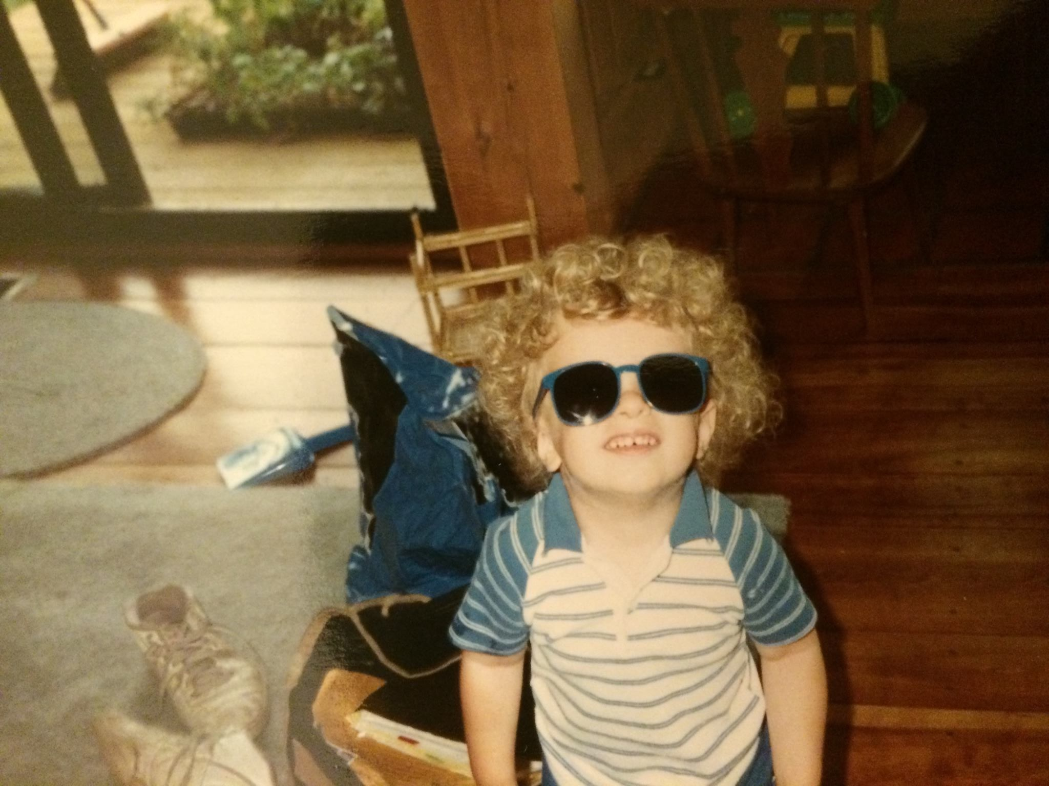
About me
Grew up in rural VT – parents are retired public school teachers
4 years organizing healthcare and service workers in Nevada, Pennsylvania, Oregon and Washington State
5 years running field on ballot initiatives, congressional campaigns, and for Washington State Democratic party
Currently run small consulting firm helping community-based organizations unions use digital and traditional organizing to build power in the PNW
Notes:
Context matters- want to share a little bit about my background so you can get an idea of the experiences and the particular perspective that lends my work, along with potential limitations

Slide 3
Plan for today
Case Study
Workshop
Using cyborg organizing to even the odds in a 2016 congressional campaign
Planning your own cyborg organizing program
Notes:
Plan for the day

Slide 4
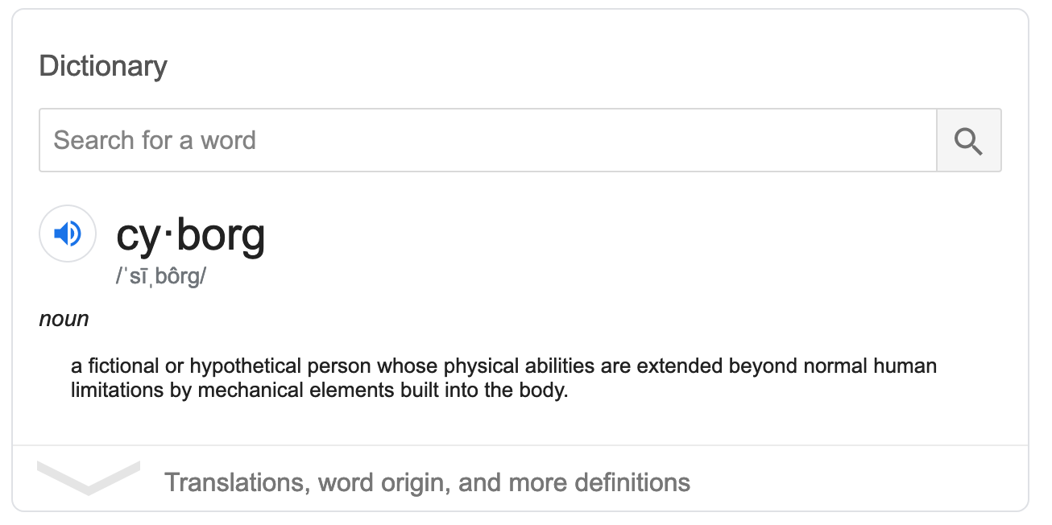
What is a cyborg?
Notes:
Combination of human and machine that enhances the human. Why are we always asked to moved from online to offline? If we’re organizing people where they are - a lot of their life is online. What if we did the best of both worlds? The power to motivate people that comes from collective action in person, and the social graph and outreach tools we get online?

Slide 5
What we’re talking about today
“Online to Offline”
Online + Offline
Treats digital as comms – broadcast tool
Limits supporters to liking and sharing – shallow engagement
Supporters have limited ownership over strategy
Treats digital as tool to make your supporters more effective
Deeper engagement from inspiring setting
Gives supporters more ownership over message and strategy

Slide 6
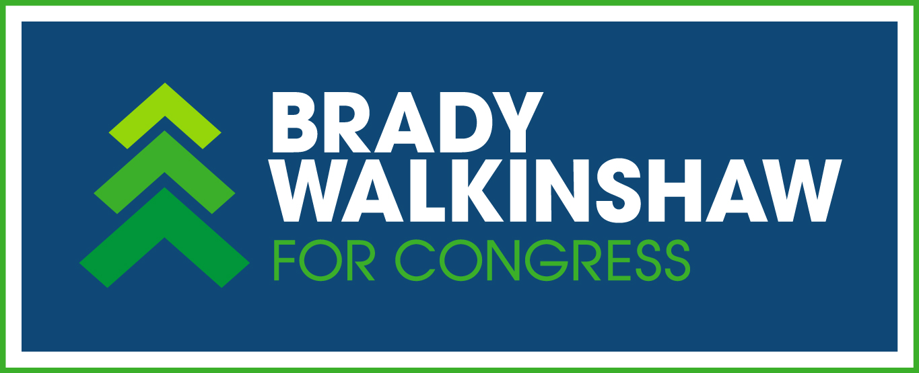
Case Study:
Brady Walkinshaw for Congress
2016 Congressional Campaign in the heart of liberal Seattle
Notes:
I want to tell you a little bit about myself and frame the conversation I’m hoping to have today. The title is intentionally a little bit of a provocative teaser – but I think it’s a nice way of thinking about what we’re trying to define today, which has to do with offline to online organizing, rather than the reverse. so what is a cyborg?

Slide 7
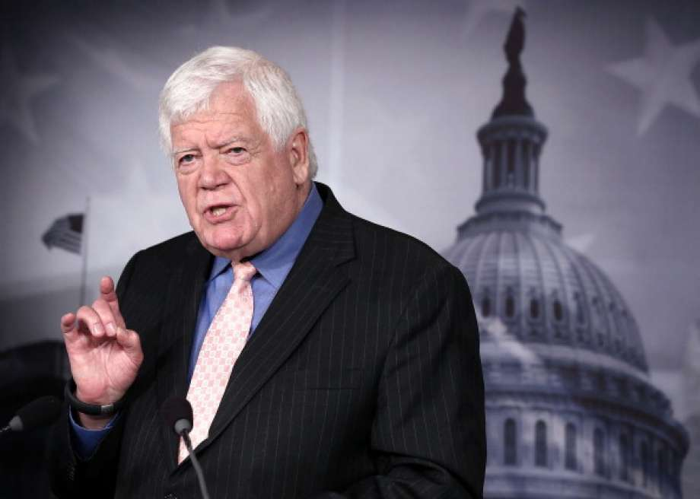
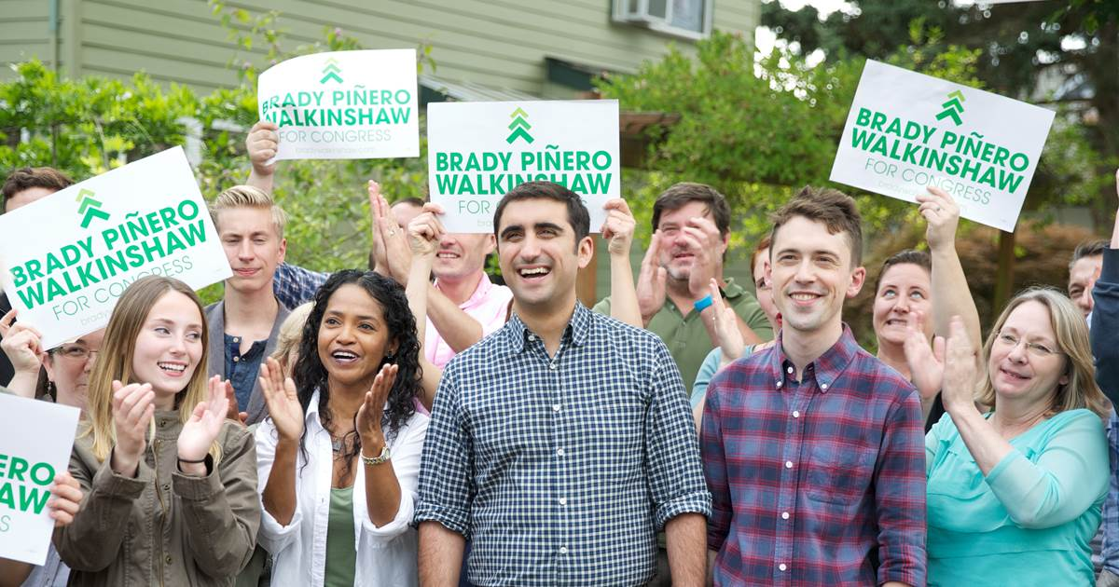
The Candidates
Jim McDermott
Brady Piñero Walkinshaw
1st gen Cuban-American
14 - term incumbent
LGBTQ
Born in 1936
Millenial
Traditional liberal
Focus on climate justice
Not a bad guy
Notes:
I want to tell you a little bit about myself and frame the conversation I’m hoping to have today. The title is intentionally a little bit of a provocative teaser – but I think it’s a nice way of thinking about what we’re trying to define today, which has to do with offline to online organizing, rather than the reverse. so what is a cyborg?

Slide 8
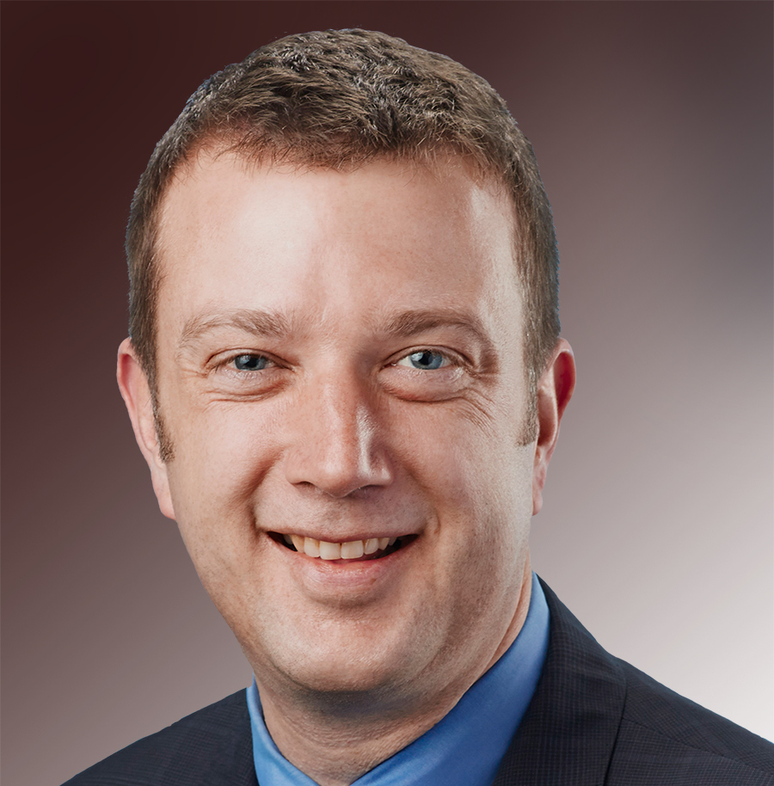
The Switcheroo
Brady Piñero Walkinshaw
Joe McDermott
1st gen Cuban-American
County Councilmember
LGBTQ
Same last name as incumbent
Millenial
Climate justice

Slide 9
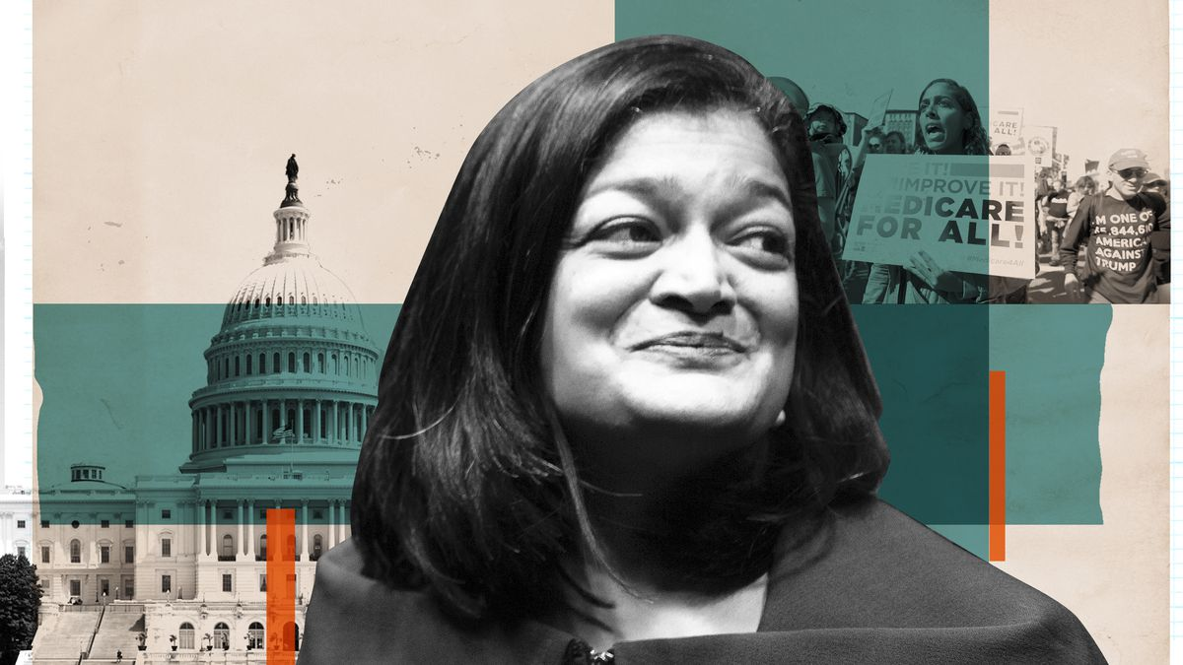
And then there were three
Brady Piñero Walkinshaw
Joe McDermott
Pramila Jayapal
1st gen Cuban-American
County Councilmember
Progressive Champion
Civil Rights activist
Immigrant
Labor leader – husband is political director of UFCW
Wildly popular
Endorsed by Bernie Sanders
I volunteered on her first state senate campaign – huge fan!
LGBTQ
Same last name as incumbent
Millenial
Climate justice
Notes:
I want to tell you a little bit about myself and frame the conversation I’m hoping to have today. The title is intentionally a little bit of a provocative teaser – but I think it’s a nice way of thinking about what we’re trying to define today, which has to do with offline to online organizing, rather than the reverse. so what is a cyborg?

Slide 10
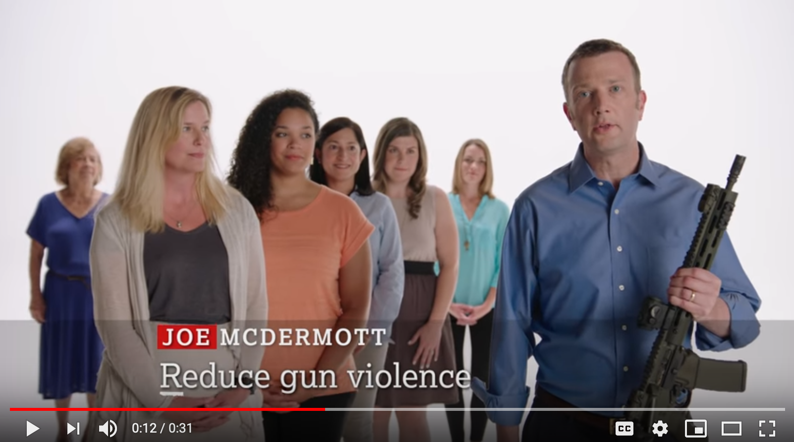
What Went Down
Brady Piñero Walkinshaw
Joe McDermott
Pramila Jayapal
Need to make it through top-2 primary
Capitalize on base in West Seattle – lots of yard signs?
Raised $$$ from labor
Swept endorsements from labor, community and progressive groups
Raised $$ from enviro donors – yay!
Keep costs low – literally had two staff members
Few vols + didn’t want to canvass
Built custom predictive model
Weird GVP ad?
STILL GOT THAT NAME, THOUGH
Hired 3x field staff as us, ran massive doorknocking campaign with ALL the volunteers
Millenials preferred Pramila – our UW organizing group was quickly dwarfed by hers
Notes:
And then it got worse. Bernie Sanders endorsed Pramila, which was like a dagger to the heart for this particular socialist with a labor background from Vermont…

Slide 11
The Realization
We had less of everything (money, volunteers, endorsements).
We had to use all of our resources much more effectively than our opponents.
Notes:
And then it got worse. Bernie Sanders endorsed Pramila, which was like a dagger to the heart for this particular socialist with a labor background from Vermont…

Slide 12
Taking Stock
Our Supporters | Disadvantages for Traditional Field Program
Older | Less willing to knock doors
Upper-middle class/professionals | Wanted to contribute “unique skill sets” rather than traditional field activities
Notes:
And then it got worse. Bernie Sanders endorsed Pramila, which was like a dagger to the heart for this particular socialist with a labor background from Vermont…

Slide 13
Pivoting to Competitive Advantages
Our Supporters | Disadvantages for Traditional Field Program
Older | - More longstanding relationships with other likely voters
Upper-middle class/professionals | Strong professional and social networks Wanted “special ask” – give them new tools

Slide 14
New Strategy
Our Supporters | Disadvantages for Traditional Field Program
Older | More longstanding relationships with other likely voters
Upper-middle class/professionals | - Strong professional and social networks - Wanted special ask – give them new tools
Use new tools to let our supporters map their social networks + reach out to voters only they can reach
=

Slide 15
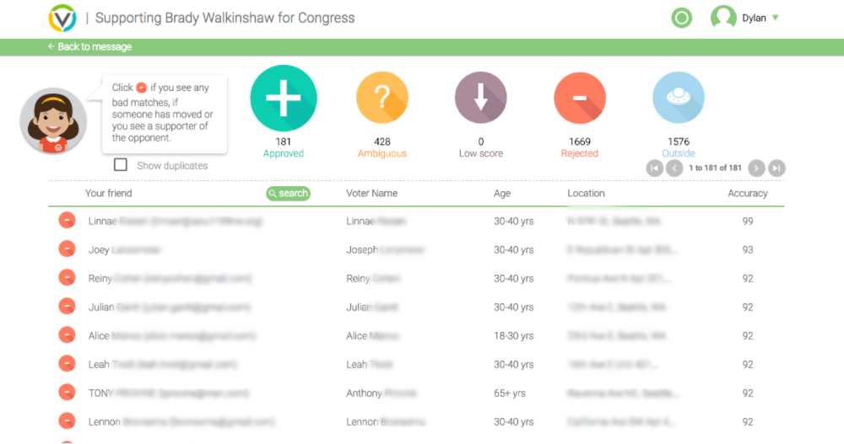
Piloting New Tools

Slide 16
Piloting New Tools: Requirements
Trust
Urgency
Offline and Online Field Program
=
Coaching
Social Pressure

Slide 17
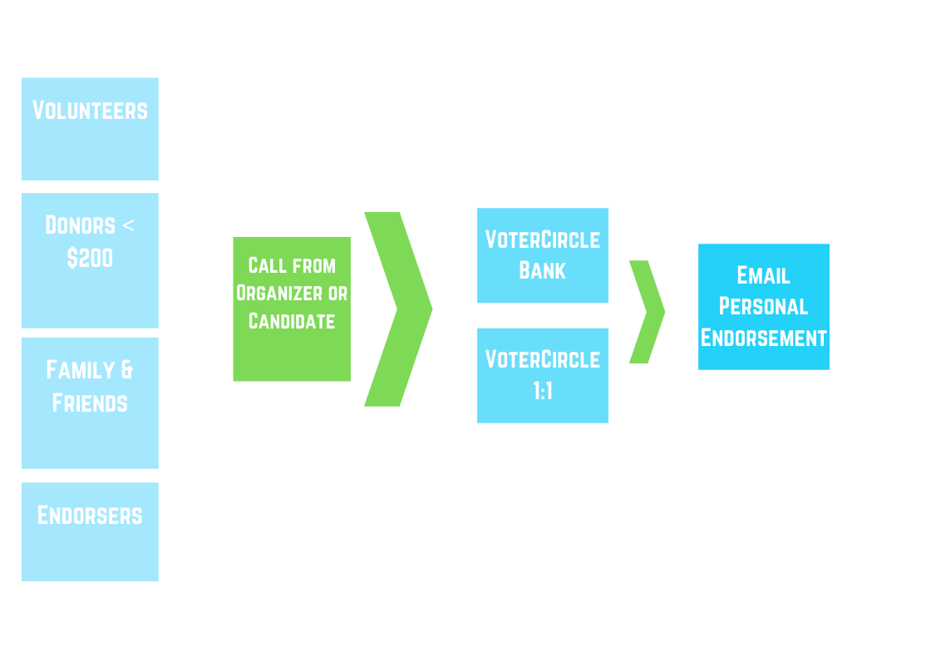
The New Model

Slide 18
The New Model
VoterCircle banks 5 nights/week at our office
– 30 mins training, 60 mins phonebank, 30 mins VC
5-10 Voter Circle 1:1s/week with high-impact supporters
Organizers worked exclusively to recruit VoterCircle users – no door or phone shifts

Slide 19
Vol Targeting Criteria
Ability to communicate with lots of voters (PTA chairs, labor folks, local elected, etc.)
Use e-mail
Geographically and demographically diverse

Slide 20
Vol Recruitment Message
More effective than doorknocking or phonebanking
Reach voters you are uniquely able to reach
Share your unique reason for supporting Brady – don’t need to use script

Slide 21
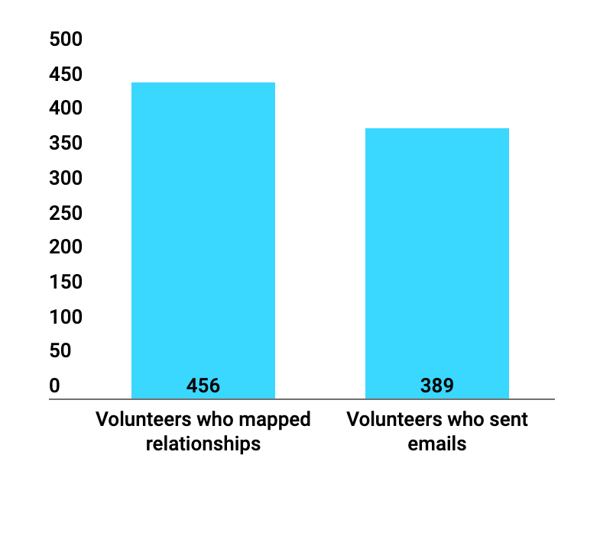
Scaling Up

Slide 22
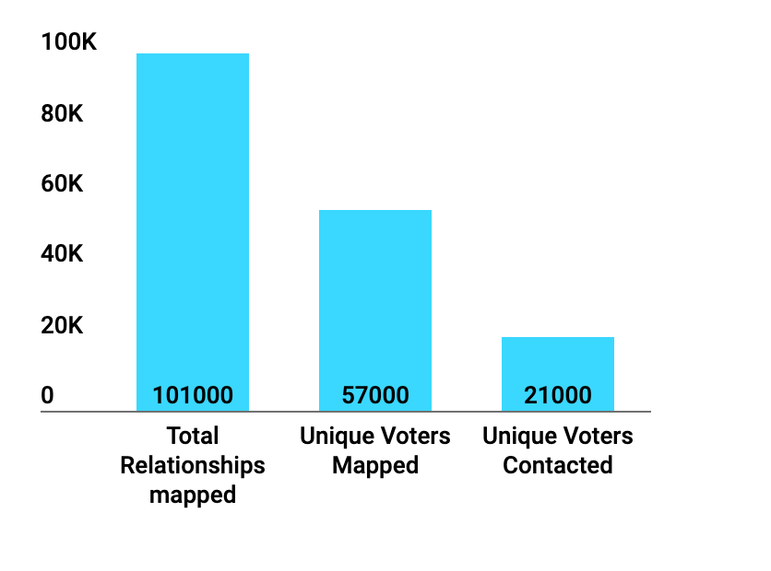
Scaling Up

Slide 23
GOTV Conundrum: Who to turn out?
Relatively few ID’d supporters from doors
No predictive model to discern our supporters vs. Pramila or Joe supporters

Slide 24
GOTV test
3-week voting period – time to test and adapt
Called through voters who had opened emails from friends about our campaign
Called control group of non-mapped voters
30,000 calls , 5,600 contacts

Slide 25
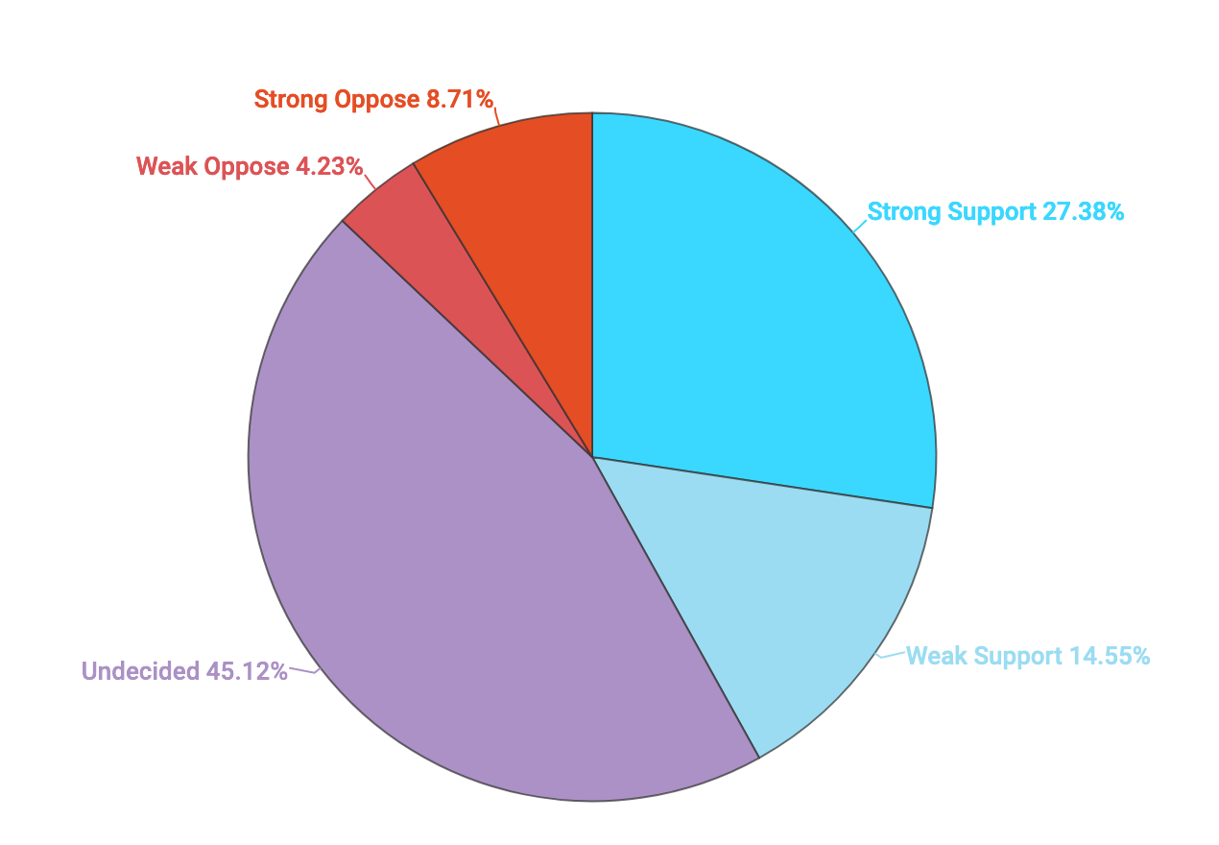
Control Group (4,040 voters)

Slide 26
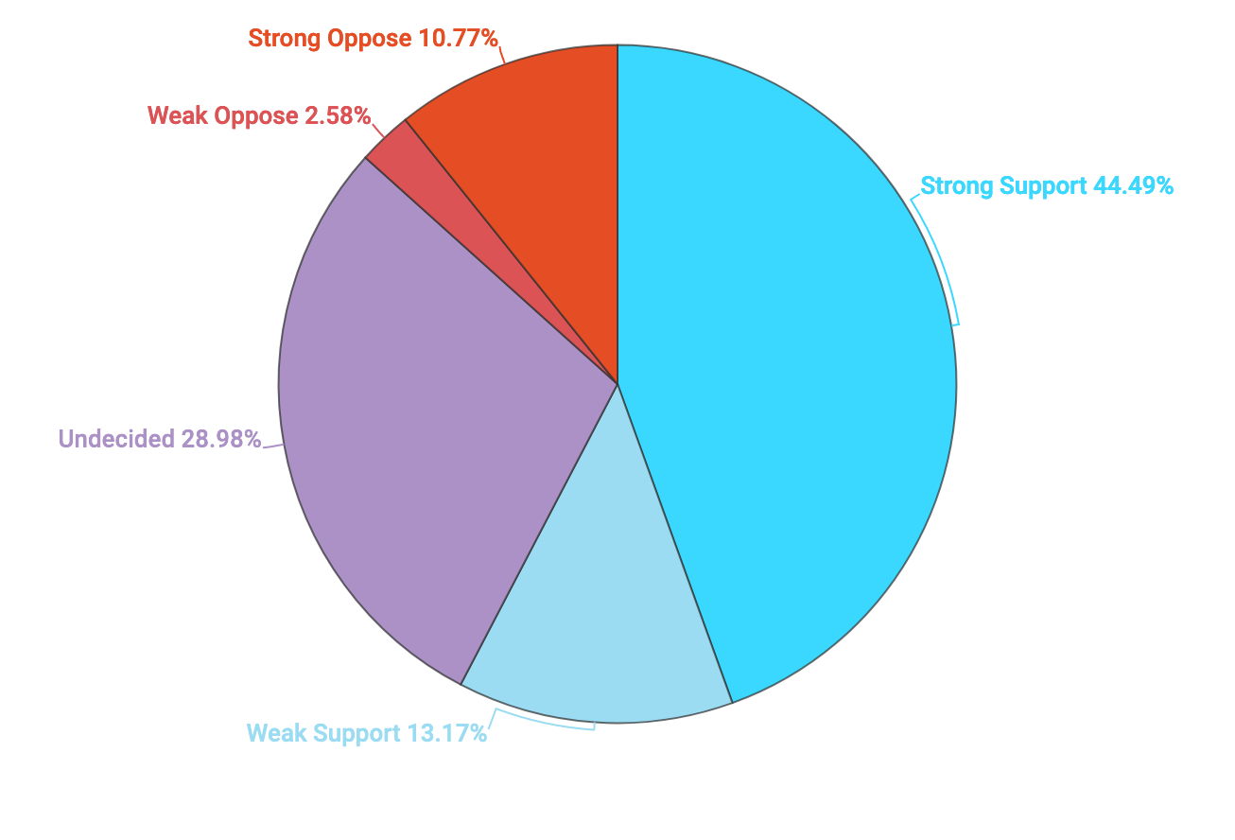
Opened Email (1,625 voters)

Slide 27
Opened Email (1,625 voters)
+ 17% strong support
- 1% weak support
- 16% unsure
- 2% weak oppose
+2 % strong oppose

Slide 28
GOTV – New Plan!
CALL AND GOTV ALL THE VOTERS WITH RELATIONSHIPS TO OUR SUPPORTERS!

Slide 29
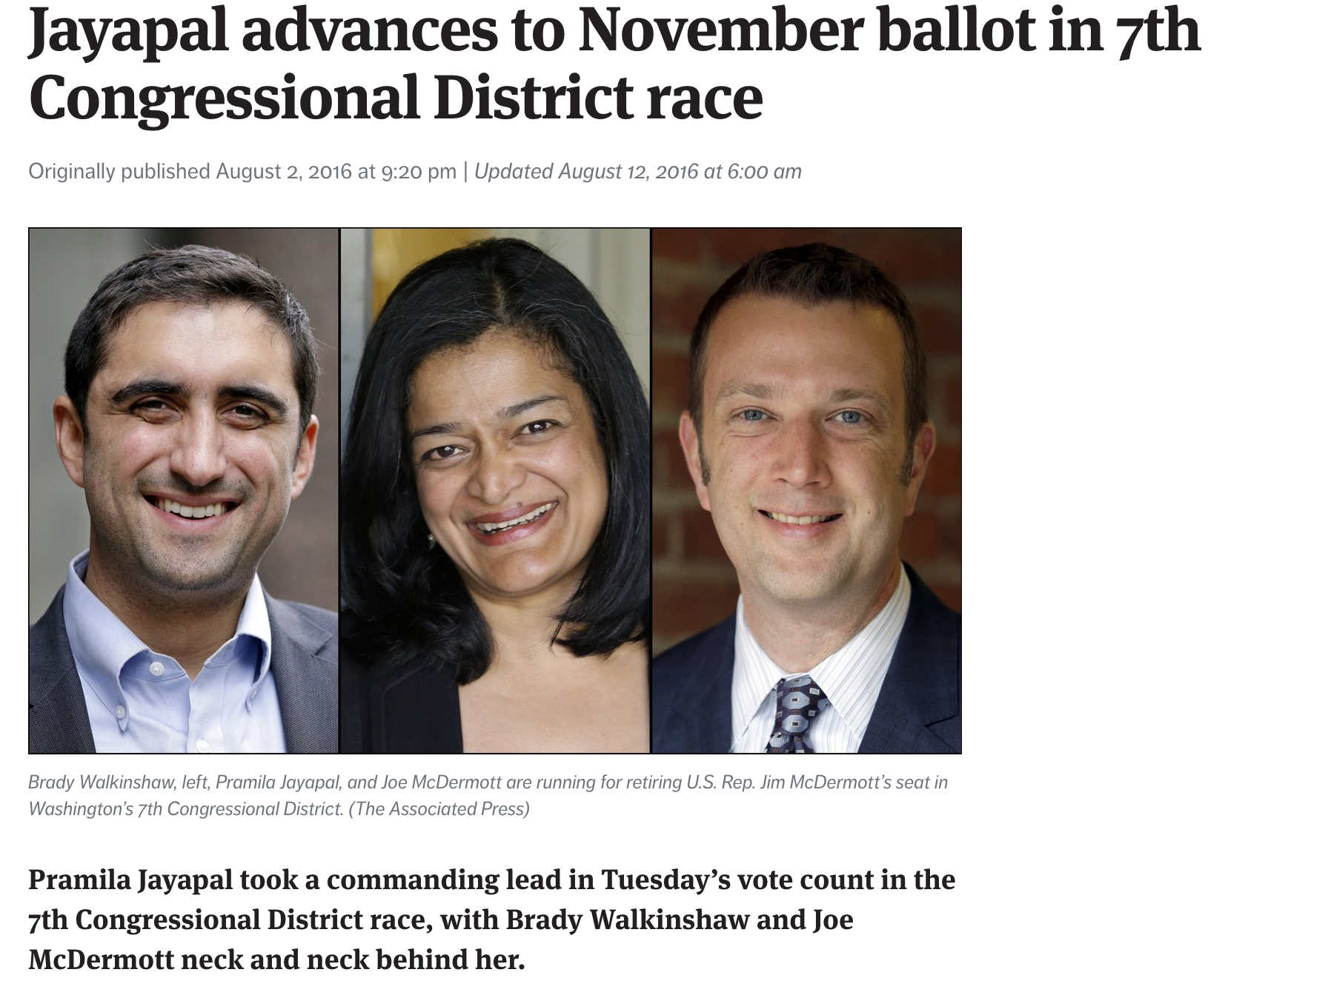
Election Night

Slide 30
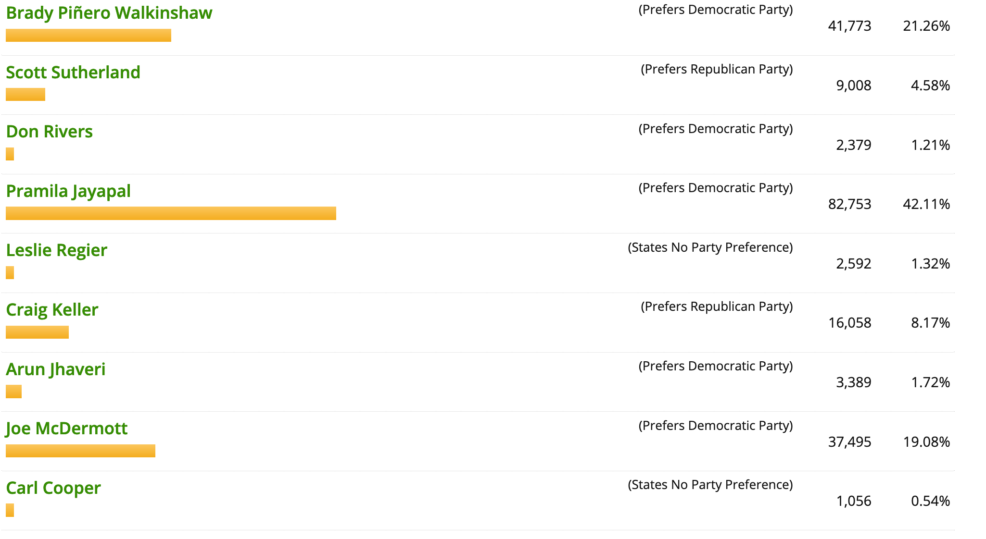
Final Primary Results

Slide 31
General Election Strategy
Double down on relational organizing
Extend the ladder of engagement

Slide 32
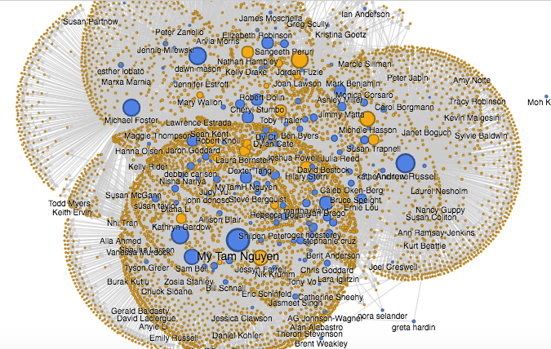
Engagement Ladder: Influencers

Slide 33
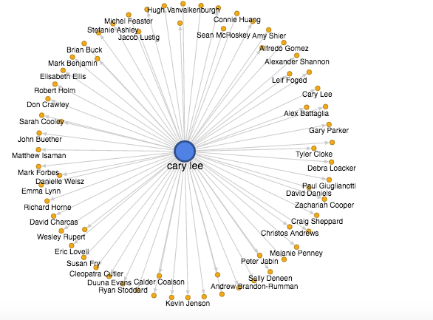
Engagement Ladder: Influencers

Slide 34
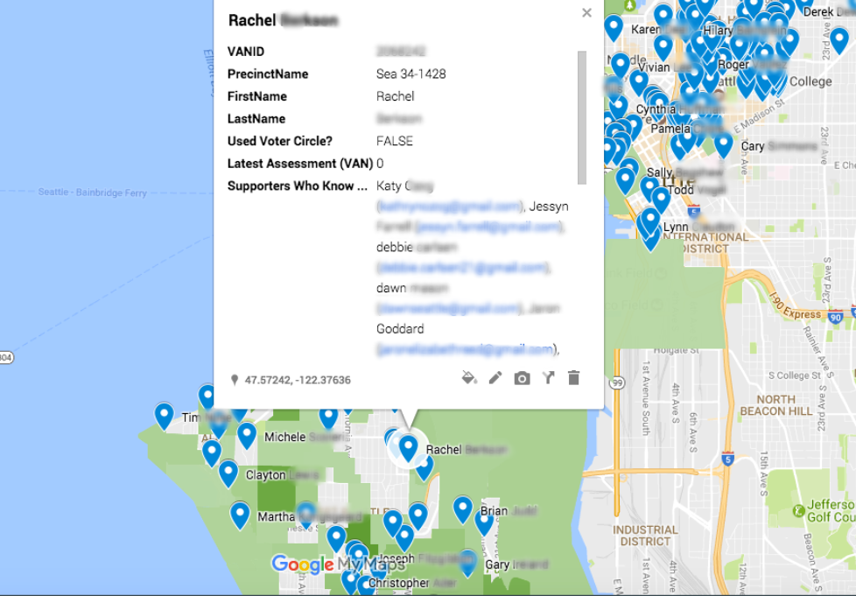
Influencers in Target Precincts

Slide 35
Building an influencer-recruiting team
Name | Number of Influencers They Know
Ricardo A. | 24
Suzie L. | 16
Mackenzie F. | 8
Amir B. | 7

Slide 36
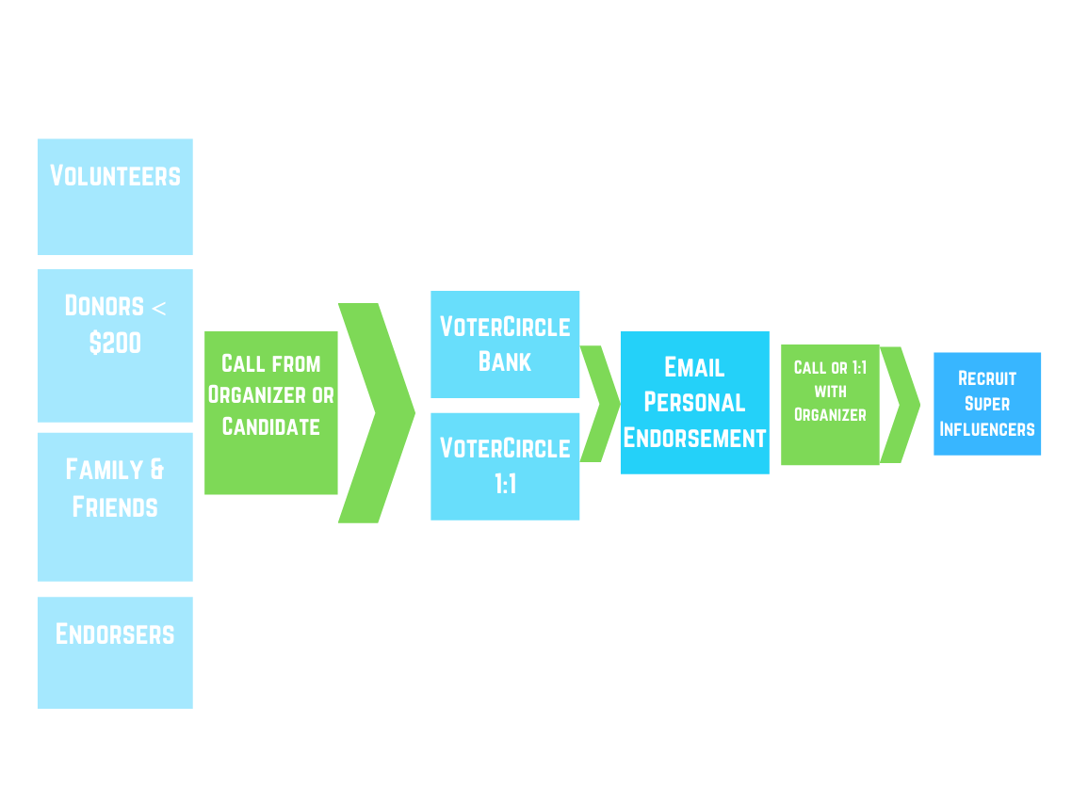
Adding a step to the engagement ladder

Slide 37
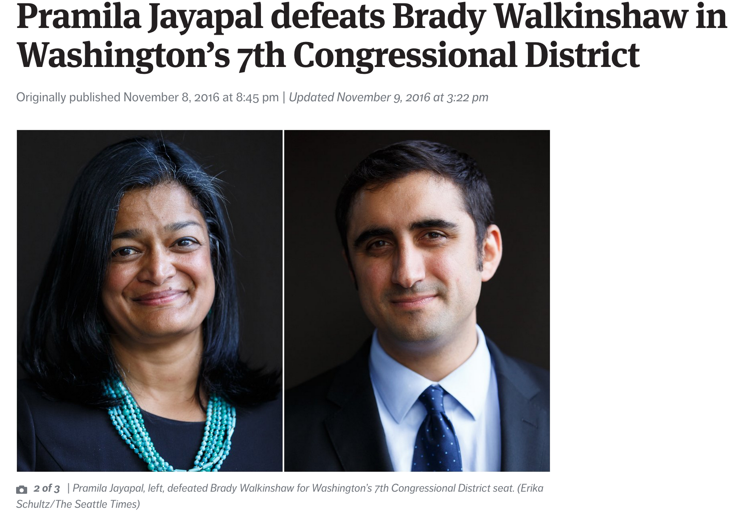
Election Night

Slide 38
Lessons Learned from Offline to Online
Meet your best supporters where they are, and get them into an environment where they’re willing to do more
Assess your supporters’ strengths, and plan program that uses them
Use digital tools to help supporters successfully deploy their strengths, or make up for weaknesses
Organize volunteers as whole people, with a social network and abilities to engage people they know

Slide 39
Questions?

